Slide 1
Challenges of Optical Character Recognition
Orville Anderson
University of Minnesota Morris, Senior Seminar, Fall 2025

Slide 2





How to make a Scanned Document
Process
Limitations
JPG
PNG
PDF
TIFF
Hegghammer, 2022
Notes:
Talking about OCR within context of scanned documents
Scanned docs are documents that you take a photo of
They come in many formats, such as…
These are great because they are easy to store and share
BUT you can’t edit or search the text on them
When take image, loose record of text
Can go back and manually type up,
OR can use OCR, which is subject of today

Slide 3
What Is Optical Character Recognition (OCR)?
Defined as: the process of extracting text from images
OCR model is something performing this process
Useful to digitize scanned documents (for research, digital accessibility, etc.)
Reduced accuracy on certain documents

Slide 4
Presentation Outline
Background
What is OCR?
Methods
Case Study
Introduction
Traits
Conclusion
Case Study Importance
Larger Picture
Stages of OCR
Results
Notes:
The background of this presentation will what OCR is, how it works and some of the techniques
The largest part of this presentation is looking at a case study.
This case study is a large collection of documents put together to evaluate accuracy
I am going to go over the motivations of the study, the specifics of the documents, then the results
I will wrap this presentation up by covering why we care about the case study and what this means for the larger field

Slide 5


OCR Stages
Image
(Scanned Doc)
Document Layout Analysis
Text Line Detection
Recogniton
Editable Text
Input
Output
Animal
A
Notes:
OCR is split into three main stages
The input to the first stage is an image
The first stage is Document Layout Analysis
Text is put into boxes
The Second stage is Text Line Detection
Regions are broken up further into lines, then words, then characters
These characters are then put into nice uniform boxes
The Last is Recognition
Recognition step is repeated on all characters found in document, then assembled
This makes the final editable and searchable document
Skipping: TLD uses pre-determined box sizes to isolate characters. There is generally some adjustments of the character, like rotating or centering it, to make the characters more uniform

Slide 6
Classification Method – Matrix Matching
Input | Processing | Output
From TLD Stage
Compare to templates
0
0
1
0
0
Label: A
0
1
1
1
0
0
1
0
1
0
A: 17 mismatched points
B: 0…
C: 6…
1
1
1
1
1
1
0
0
0
1
1
0
0
0
1
1
1
1
1
0
Foundational classification method
Patented in early 1930s
In use into the 1990s
1
1
1
1
0
1
0
0
0
1
1
0
0
0
1
1
1
1
1
0
1
0
0
0
1
1
1
1
1
0
1
0
0
0
1
1
0
0
0
1
1
1
1
1
0
1
0
0
0
1
0
1
1
1
0
Label: B
1
1
1
1
0
1
0
0
0
1
1
0
0
0
0
1
0
0
0
0
1
0
0
0
1
Label: C
0
1
1
1
0
Diagram inspired by LI
Notes:
[Transition: There are two main recognition methods I will cover, the first is Matrix Matching]
One of the original methods
In use for over 60 years (1930s into the 1990s
Matrix Matching works on individual characters (the one from the Text Line Detection Step)
This is generally cleaned up a bit, so the character is centered and not titled.
Pixels are converted to binary to make this more efficient
The unknown character is compared to a library of character templates
The output of this process is how similar to the unknown character each template was
The resulting character is the identity of the template that was the most similar

Slide 7
Classification Method – Neural Network
A more complex version of Matrix Matching
Matrix Matching – each pixel has uniform impact
Neural Networks – each pixel and outcome has an associated weight
Easier to update collection of known characters
Allows us to identify full lines of text at once
Pattern recognition
+ some standardizing
Each possible outcome (character) and a confidence %
Notes:
[Transition: The second method I am going to cover today is using Neural Networks]
This method works very similar to Matrix Matching
In Matrix matching each mismatched pixel has the same impact on the output
In Neural Networks, each pixel of the unknown character and each possible outcome has a special value called a weight
[diagram break]
This gives us more flexibility in characters, characters don’t need to perfectly match up
Because of the more control we have over the outcome, we can add a clause to accept unknown characters
Because of the increased flexibility we can identify full lines of text
This has its pros and cons, but it reduces the amount of dividing and cleaning text we need to do
Neural Networks have the advantage of a bit more flexibility in what it considers it’s collection of “known characters”.
Define Training

Slide 8
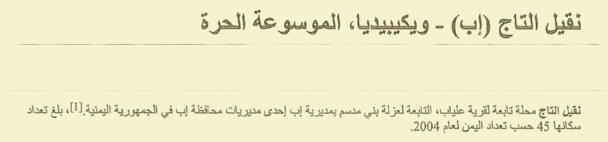
Summary
ABCDEFGHIJKLMNOPQRSTUVWXYZ
abcdefghijklmnopqrstuvwxyz
0123456789
.,!@#$%^&*()
Limited to “known characters” and fonts
Need examples of more characters and fonts
Hegghammer, 2022
Case study is a document collection to evaluate accuracy, but can be used to train
Notes:
[That was a lot, so here’s a recap]
The two important things to know are
These methods are limited to some “known characters” and fonts.
This used to be extremely limited
The alphabet shown is actually a font type developed for OCR
Techniques like using Neural Networks give us more flexibility
Neural Networks need to be exposed to a variety of characters to
We need more examples of characters and fonts
Like the Arabic shown to the left
The Case Study I am about to get into is a document collection made to evaluate accuracy, but these documents can also be used to train these models.

Slide 9
Case Study
How accurate are general OCR models on documents found in social studies and humanities research?
Thomas Hegghammer, 2021
Historian who works with Arabic texts
Collection is called Noisy OCR Dataset (NOD)
Focus on noise, layout, and language
Source Documents
Old Books
Apply Noise
Apply OCR
Used 3 popular models from the time
Arabic Wikipedia

Slide 10
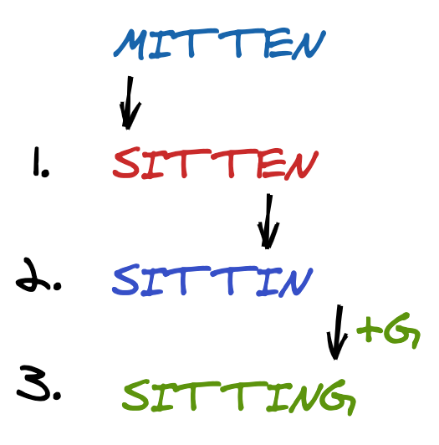
Comparison
Many ways to compare OCR models
For accuracy:
Need OCR output
Need ground truth
Judge accuracy by individual characters
OCR Output
Ground Truth
[algodaily.com]
Notes:
Now I keep on talking about comparing models. There are many ways to do this
There are many ways to compare OCR implementations, such as if you need to pay to use them and what languages they can be used on.
The case study we are about to talk about is primarily comparing three implementation based on character accuracy. He measures accuracy as the number of insertions, deletions and substitutions needed to make the OCR output match the ground truth. The number of modifications is then divided by the number of characters from the document, to make it a percentage.

Slide 11
Layout
Examples are of English old books [Hegghammer, 2022]
Arabic Wikipedia articles had limited layout variation
Does not include two column layouts and tables

Slide 12
Preserving Layout
Image
(Scanned Doc)
Document Layout Analysis
Text Line Detection
Recogniton
Editable Text
1
Reconstruct order of text
2
1
Record order of text
3
2
1
3
4
3
4
2
5
4
6
5
5
6
6
Notes:
Remember the stages of OCR? Remember how in DLA we needed to mark the order of text regions? Remember how when we combined the individual characters to make the editable text they needed to be put back in order?
Some awareness is needed to use OCR on documents that are not just one single text column.

Slide 13
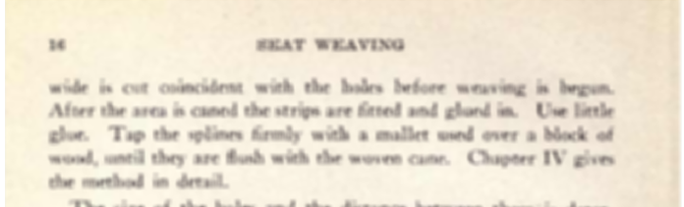
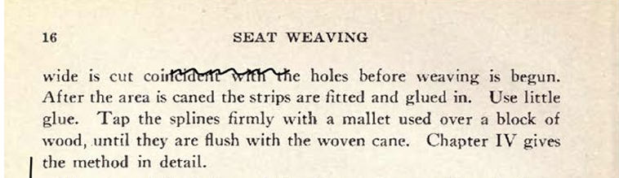
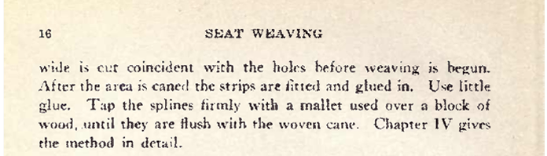
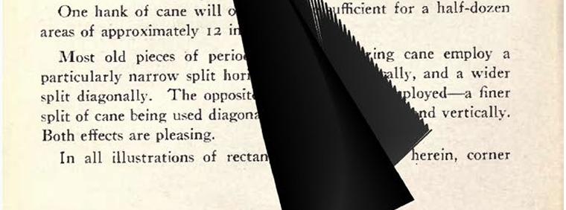
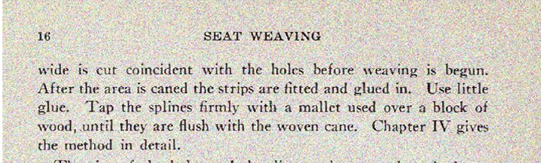
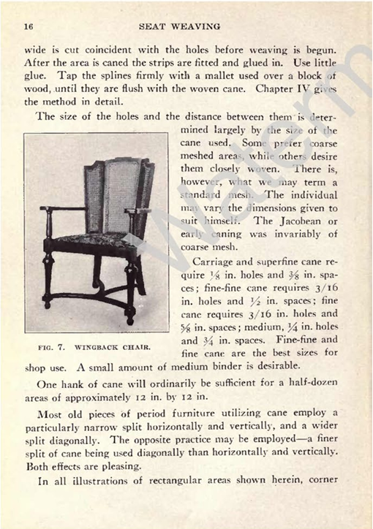
Noise
Integrated
Superimposed
Picked because they are the most common noise found in historical documents
Falls into two categories:
Integrated: built into page
Superimposed: added on top of text
Noise can obscure and/or add characters
Blur
Scribbles
Weak Ink
Ink Stain
Salt and Pepper
Watermark
Examples from Hegghammer, 2022
Notes:
Explain each of the noise types

Slide 14

Impact of Noise
Mistaken for text:
Remove noise (pre-processing)
Spellcheck (post-processing)
Obscured Text:
OCR needs to know what to do with the unreadable space (related to layout struggles)
Hegghammer, 2022

Slide 15
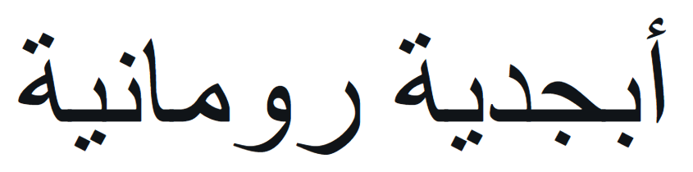
Writing Systems
Most OCR are made for Latin based written languages: English, Spanish, German, etc.
Latin is the most widely used writing system
OCR Recognition is limited to characters it has been exposed to previously
Arabic, the third most widely used writing system is very different from Latin
Diacritics
Cursive or connected characters

Slide 16
Why is Writing System a Challenge
Need to adjust Text Line Detection box sizes
Noise prevention techniques can remove diacritics
Example of output from a model which uses full lines of text
Areas with low confidence
Fateh, 2023
Notes:
Remember my comment about the TLD stage using predetermined box sizes? Some studies found that cursive characters need larger boxes
Remember noise prevention techniques? What do you think those do to diacritics?
Example text is about a Swiss architect wining a challenge to design a French park

Slide 17
Results – Models, Writing Systems, and Layout
Some OCR models cost money
Some were easier to use
Some had limited support for languages
Layout variety was minimal – a limitation
Model | Paid? | User Interface? | Arabic?
Google Document AI | Yes | Yes | Yes
Amazon Textract | Yes | Yes | No
Tesseract | No | No | Yes
Notes:
As mentioned earlier Hegghammer is an academic working with a large amount of documents. He spends a bit of time talking about price,
Need to actually talk about accuracy differences in writing systems, maybe also mention his lack of discussion on layout’s impact.
Fun fact, like all of these have changed

Slide 18
Results – Noise
Documents with multiple types of noise added, had lower accuracy
Some noise types had a larger impact on accuracy
Blur
Weak Ink
Salt and Pepper
Hegghammer, 2022
Notes:
The horrible, evil, tables

Slide 19
Case Study Significance
Insight on impact of noise
Commentary for other academics
Document collection and data is publicly available
Noise generator is publicly available

Slide 20


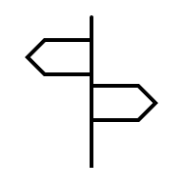
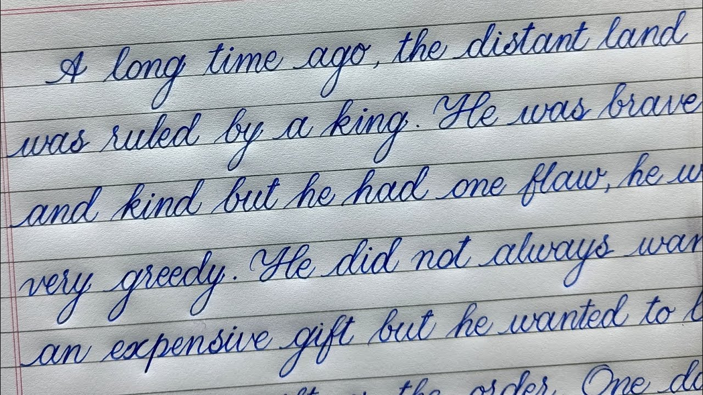
Larger Picture
[hegghammer.net]
Guides future research
Increases number of datasets and related tools
Addresses specific needs
Addresses broader needs
[Palash Calligraphy]
Notes:
For a general content analysis, an accuracy of 99.9% is workable, but for large amounts of documents and an application which requires truthful representation of the text, every character matters.
If we treat these document features as extremes, the techniques can still be applied in current cases (handwriting OCR)

Slide 21
Questions?

Slide 22
Sources
Hegghammer, T. OCR with Tesseract, Amazon Textract, and Google Document AI: a benchmarking experiment. J Comput Soc Sc 5, 861–882 (2022). https://doi.org/10.1007/s42001-021-00149-1
Fateh, Amirreza, Mansoor Fateh, and Vahid Abolghasemi. “Enhancing Optical Character Recognition: Efficient Techniques for Document Layout Analysis and Text Line Detection.” Engineering Reports 6, no. 9 (December 14, 2023). https://doi.org/10.1002/eng2.12832.
Vaughan, Don. 2025. The World’s 5 Most Commonly Used Writing Systems. https://www.britannica.com/list/the-worlds-5-most-commonly-used-writing-systems
Wikipedia contributors. 2025. Arabic diacritics — Wikipedia, The Free Encyclopedia. https://en.wikipedia.org/w/index.php?title=Arabic_diacritics&oldid=1317677291 [Online; accessed 26-October-2025].
Li, Ning. ‘An Implementation of OCR System Based on Skeleton Matching’. University of Kent, Canterbury, UK: University of Kent, Computing Laboratory, March 1993. https://kar.kent.ac.uk/21129/.
Schantz, Herbert F. The history of OCR, optical character recognition. Manchester Center, Vt: Recognition Technologies Users Association, 1982.
Unless otherwise specified, all images are Adobe PowerPoint graphics or made by the Author

